Slide 1
Machine Learning Systems (294-162)
Joseph E. Gonzalez
Co-director of the RISE Lab jegonzal@cs.berkeley.edu

Slide 2
About Me

Slide 3
About Me
Co-director of the RISE Lab
Co-founder of Turi Inc.
Research
Machine Learning
Distributed Systems
Computer Vision
Autonomous Driving
Secure Learning
…

Slide 4
My story …
Machine Learning
Learning
Systems

Slide 5
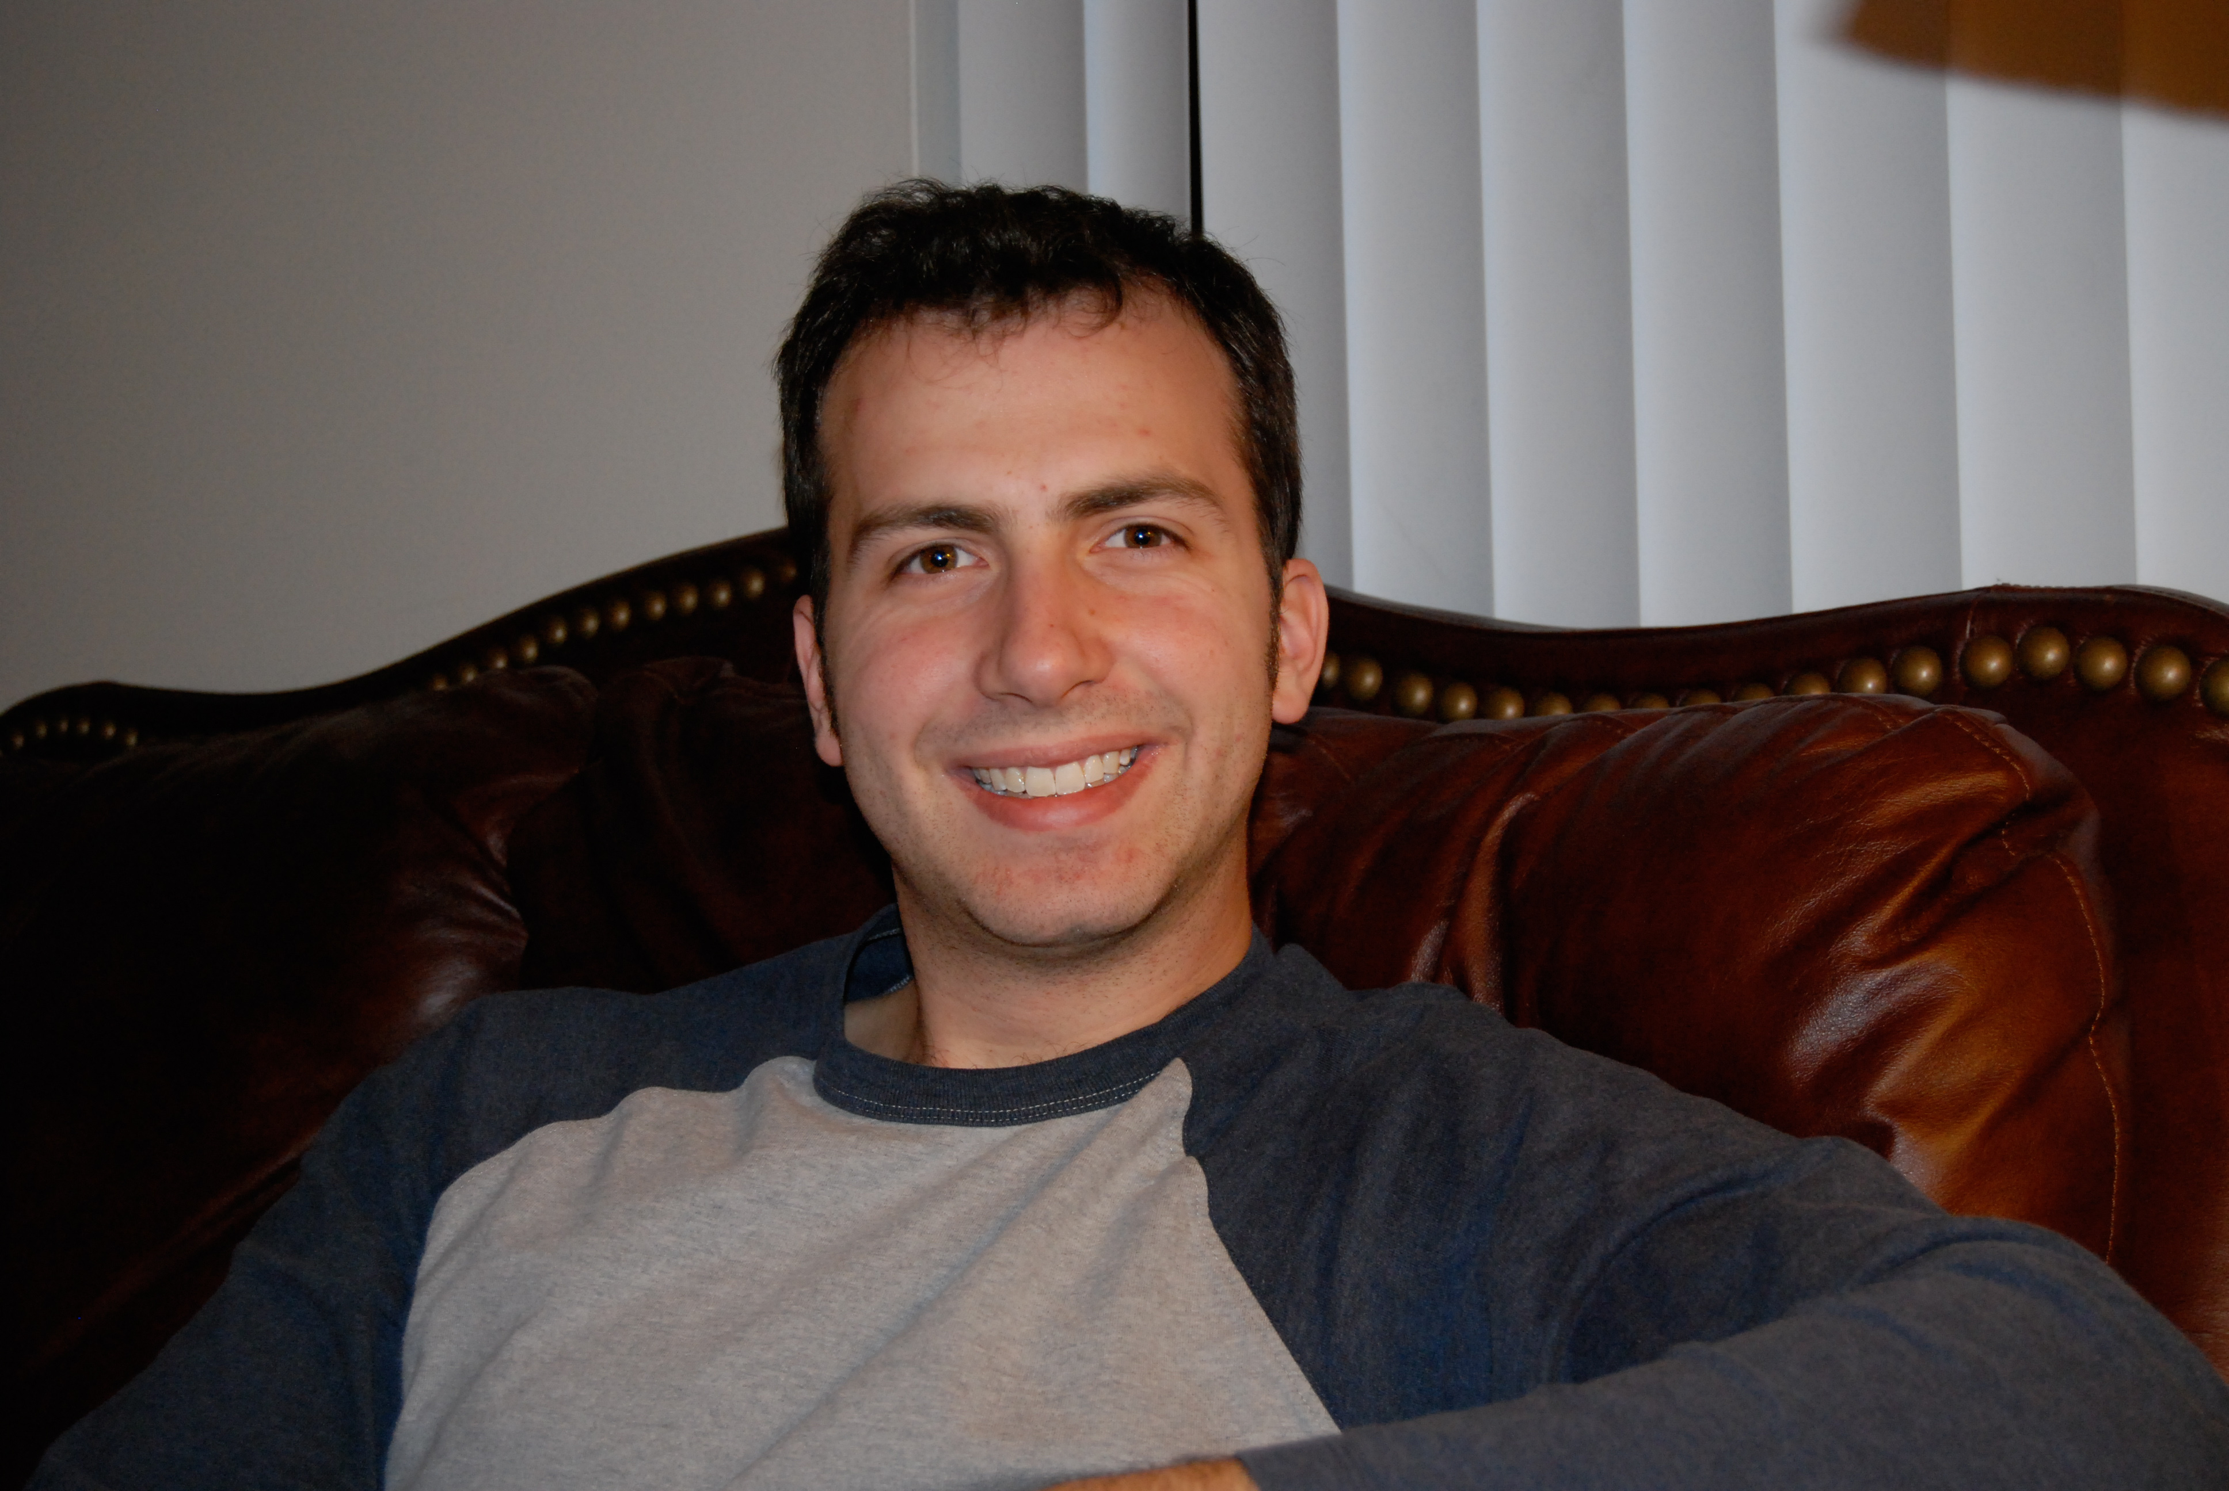
Back in 2007

Slide 6
Back in 2007
I started studying the use of Gaussian Process (GP) models for wireless link quality estimation
Research was slowed by the speed of training
… and the fact that link quality is difficult to predict

Slide 7
Back in 2008
I started studying the use of Gaussian Process (GP) methods for wireless link quality estimation
I started studying parallel inference algorithms and systems
I designed and implemented parallel learning algorithms on top of low-level primitives …
Research was slowed by the speed of training
… and the fact that link quality is difficult to predict

Slide 8
ML
Paper
Application
Idea
Model +
Algorithm
Evaluate
Debug
Optimize
Distributed
Prototype
Serial
Prototype
Optimize
Parallel
Prototype
Evaluate
ML
Paper
Debug

Slide 9
Low-Level Primitives
Shared Memory Parallelism: pThreads & OpenMP
Distributed Communication: Actors & MPI
Yes,… I built an RPC framework and then an actor framework
Hardware APIs + Languages: GPU Programming (CUDA)
Low-level parallel primitives offer fine grained control over parallel execution.

Slide 10
Advantages of the Low-Level Approach
Extract maximum performance from hardware
Enable exploration of more complex algorithms
Fine grained locking
Atomic data-structures
Distributed coordination protocols
My implementation is better than your implementation.

Slide 11
Limitations of the Low-Level Approach
Repeatedly address the same system challenges
Algorithm conflates learning and system logic
Difficult to debug and extend
Typically does not address issues at scale: hardware failure, stragglers, …
Months of tuning and engineering for one problem.

Slide 12
Interesting Machine Learning
Research
ML
Paper
Application
Idea
Model +
Algorithm
Evaluate
Interesting Systems Research
Debug
Optimize
Abstraction
Distributed
Prototype
Serial
Prototype
Optimize
Parallel
Prototype
Evaluate
ML
Paper
Debug

Slide 13
Design Complexity
Parallelism
Model
Network
Locality
Large-Scale
Systems
Machine Learning
Stragglers
Scheduling
Training
Accuracy
Fault Tolerance

Slide 14
Design Complexity
Parallelism
Model
Network
Locality
Interaction
Large-Scale
Systems
Machine Learning
Stragglers
Scheduling
Training
Accuracy
Fault Tolerance
Notes:
----- Meeting Notes (6/16/14 16:21) -----
Move items into the black box

Slide 15
Design Complexity
Parallelism
Model
Network
Locality
Interaction
Large-Scale
Systems
Machine Learning
Stragglers
Scheduling
Training
Accuracy
Fault Tolerance
Learning systems combine the complexities of machine learning with system design
Notes:
----- Meeting Notes (6/16/14 16:21) -----
Move items into the black box

Slide 16
Managing Complexity Through Abstraction
Learning Algorithm
Common Patterns
Identify common patterns
Define a narrow
interface
Abstraction (API)
System
Exploit limited abstraction
to address system
design challenges
Parallelism
Data Locality
Network
Scheduling
Fault-tolerance
Stragglers
Notes:
----- Meeting Notes (6/16/14 16:21) -----
fault tolerance check hyphen

Slide 17
PhD in Machine Learning from CMU 2013
Scalable
Systems
Abstractions
Machine Learning
X₃
X₂
Machine 1
Machine 2
Y₃
X₁
Y₂
Y₁
Graphical Model Inference
Vertex
Program
GraphLab/GraphX
System

Slide 18
Looking Back on AI Systems
How did the field evolve during the time I was doing my PhD

Slide 19
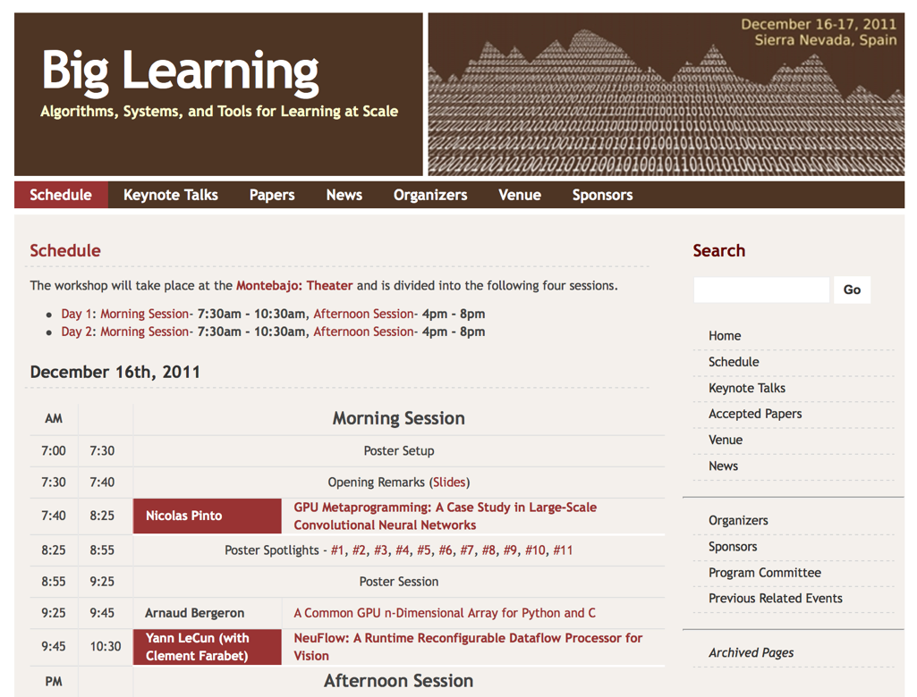
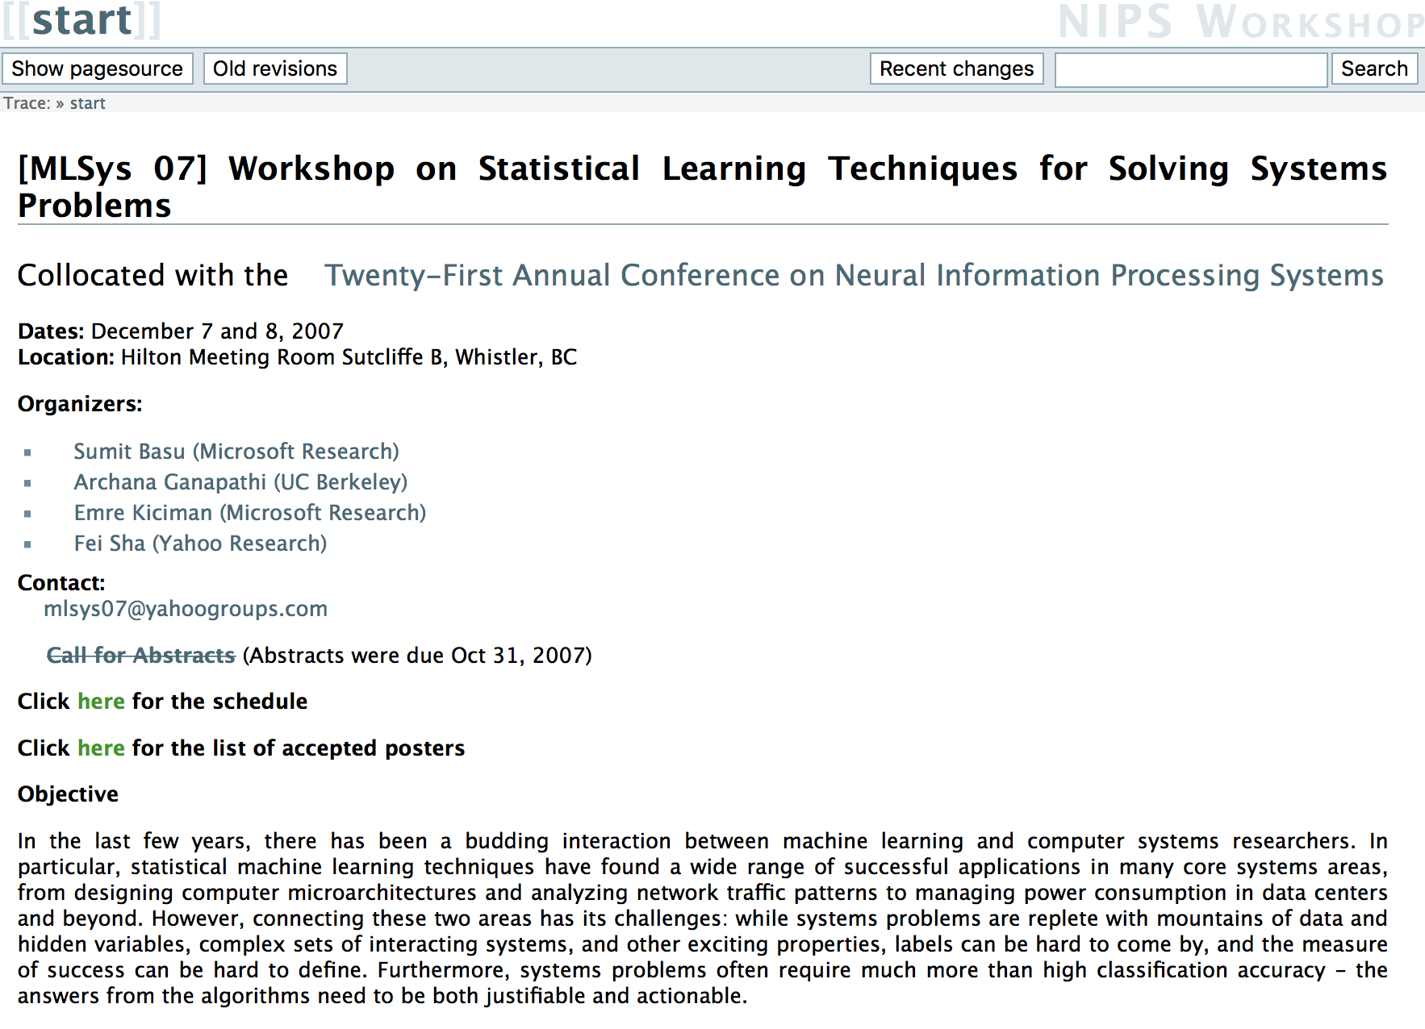
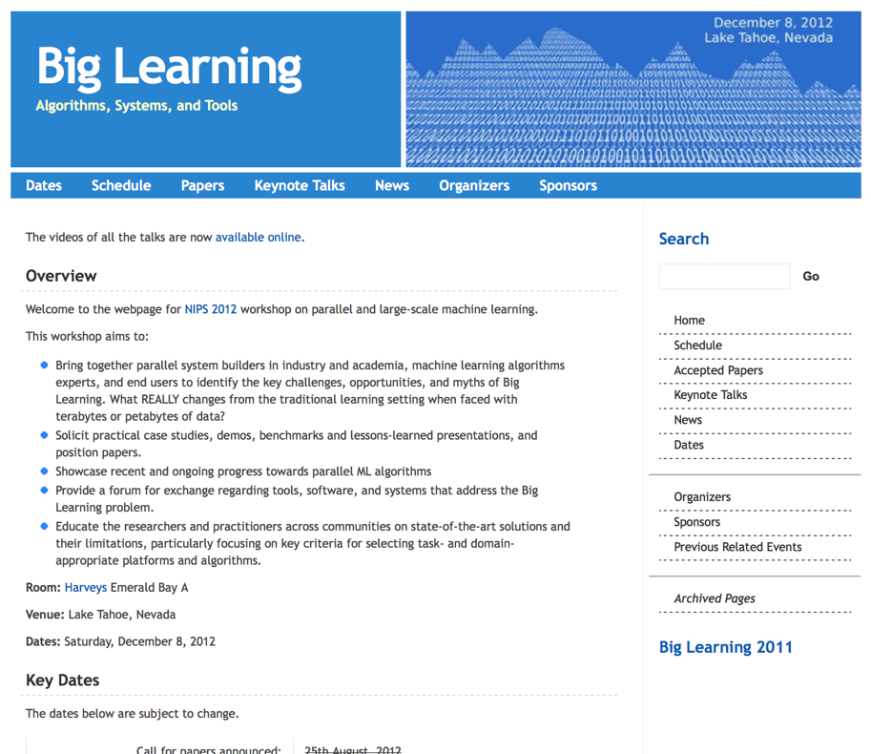
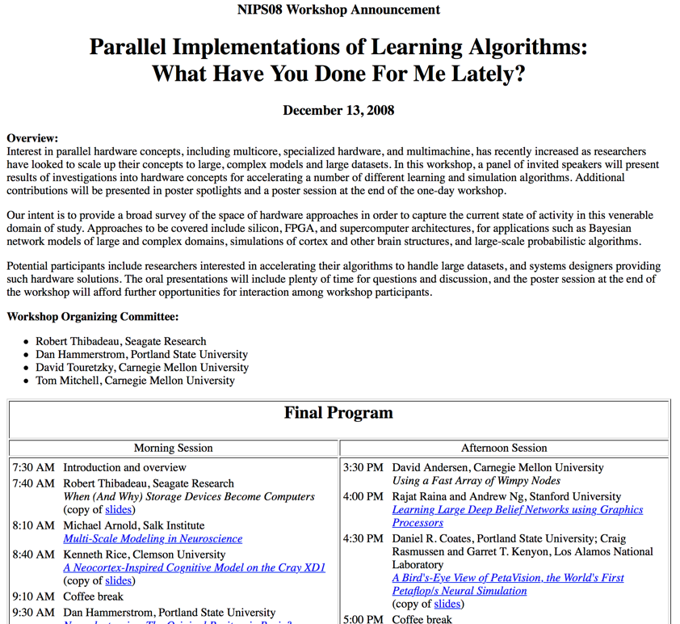
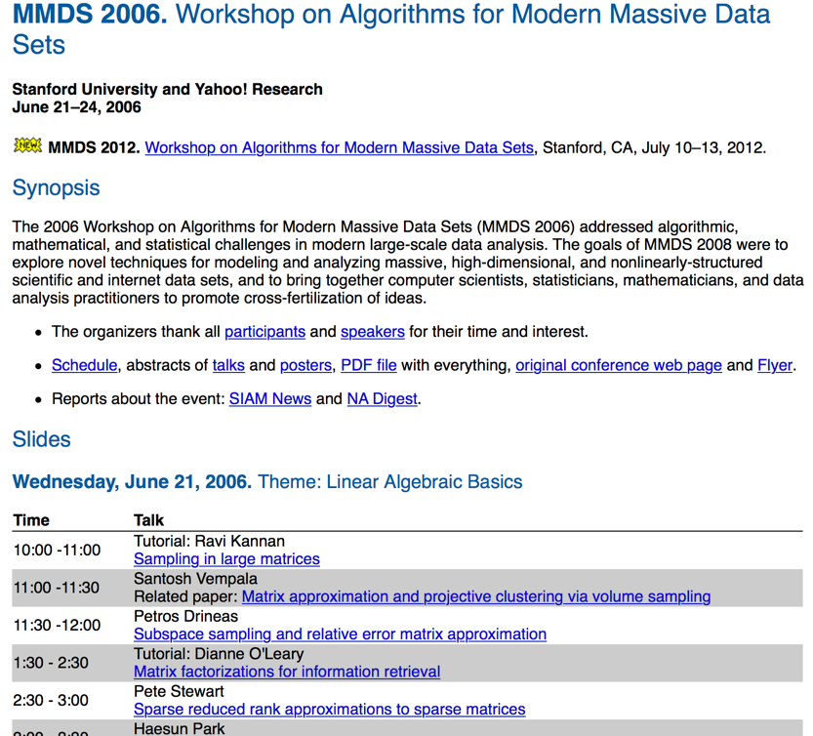
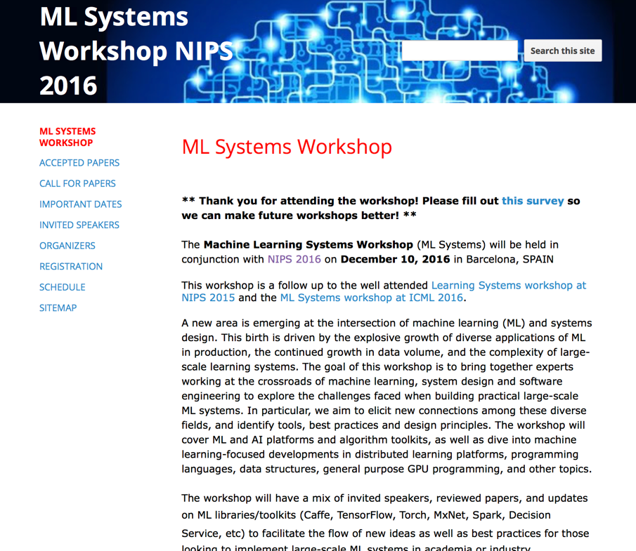
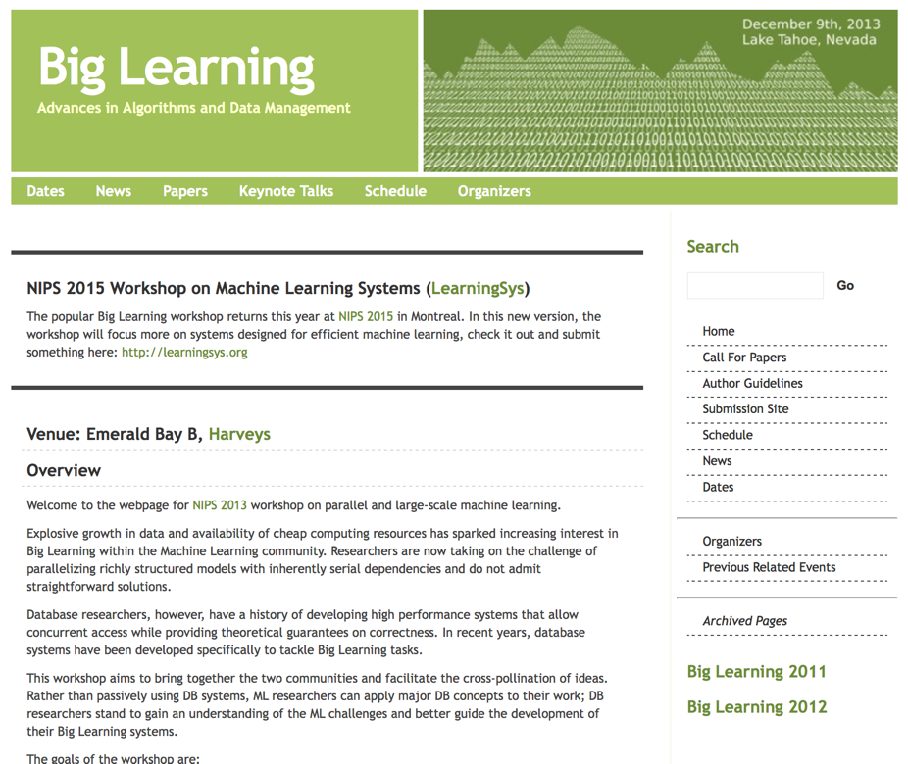
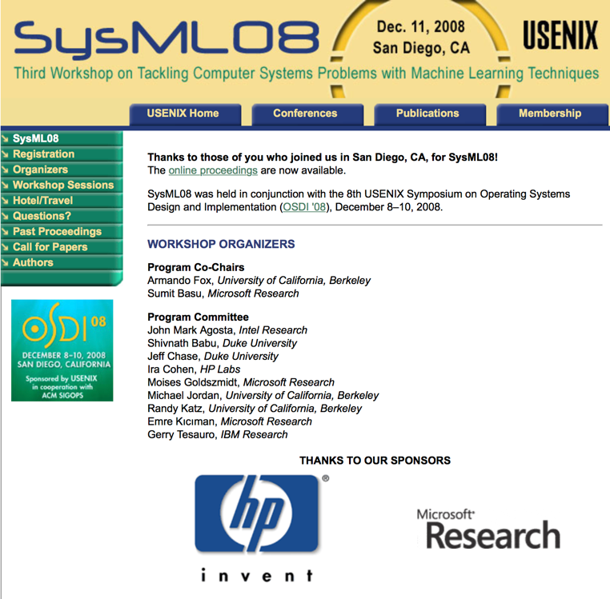
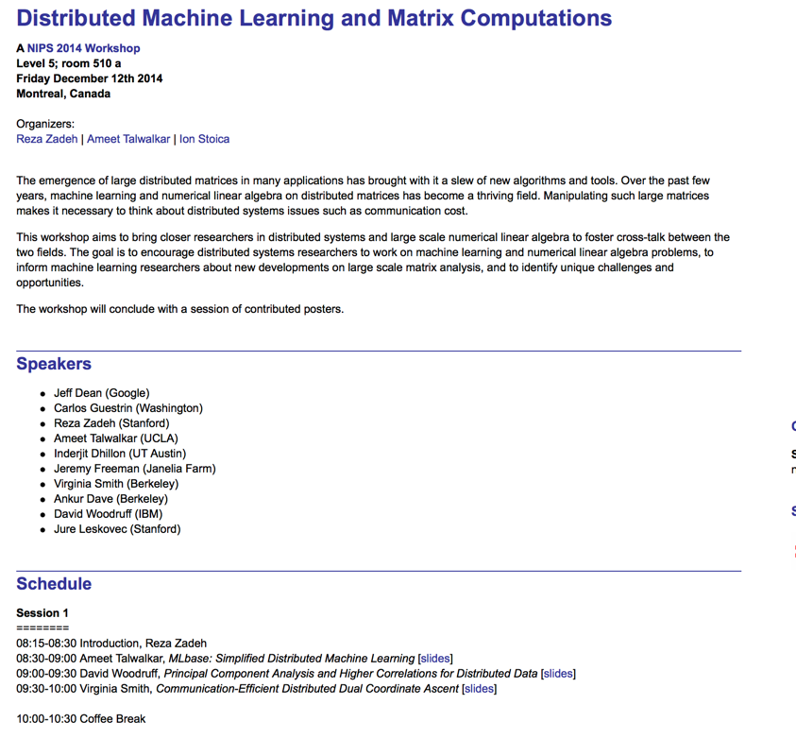
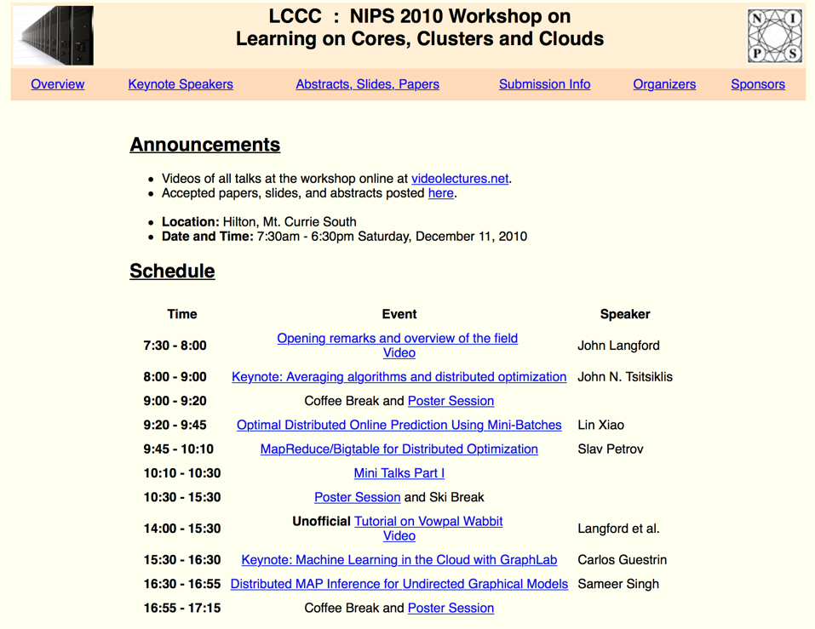
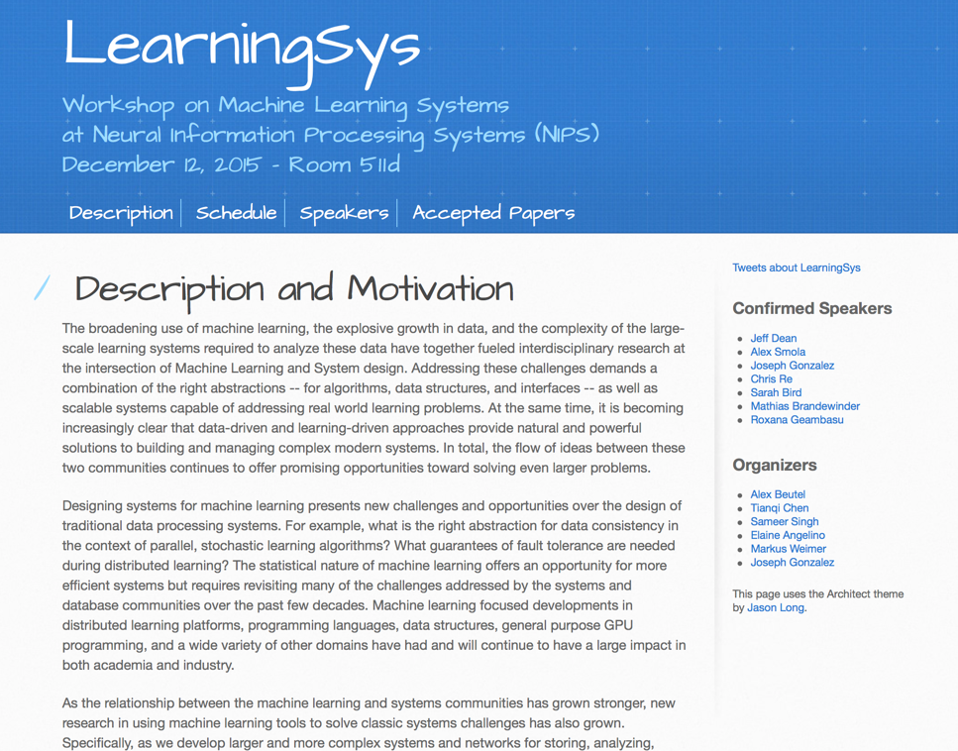
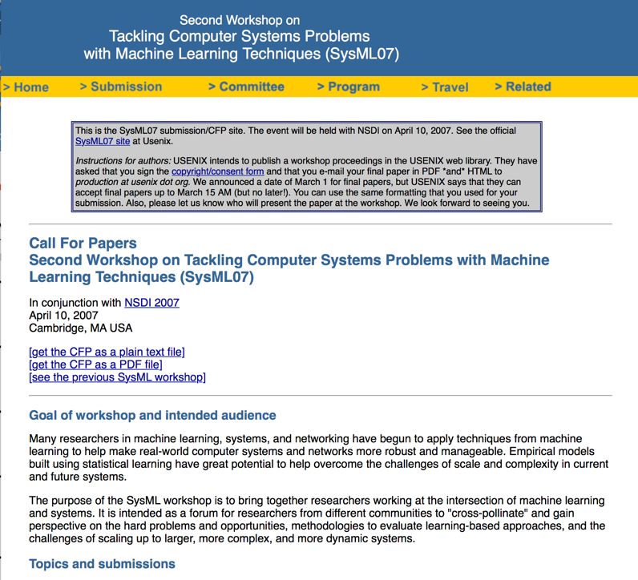
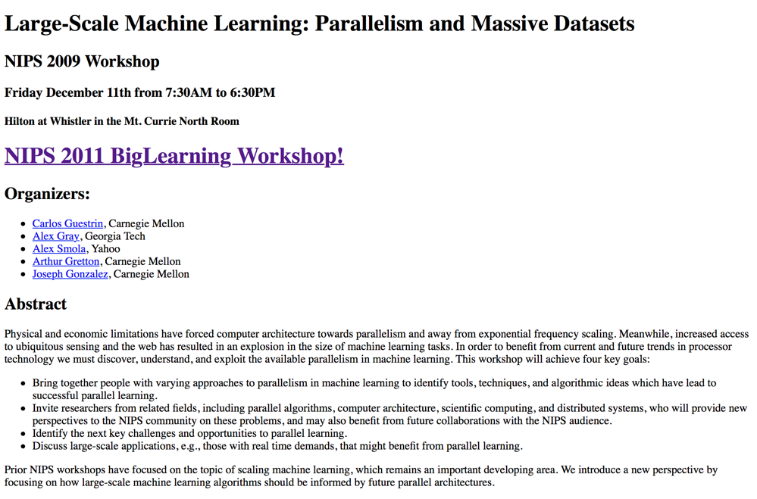
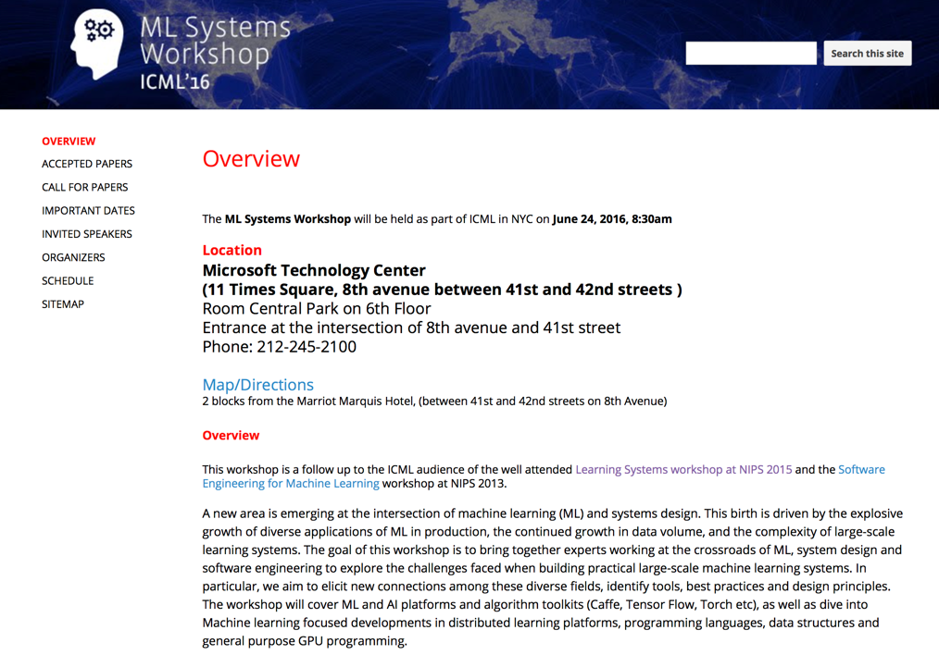

Slide 20
Machine learning community has had an evolving focus on AI Systems
Fast
Algorithms
Distributed
Algorithms
Deep Learning
Frameworks
2009
2019
ML for
Systems
Machine Learning Frameworks
RL for
Systems
Integration of
Communities

Slide 21
Systems and the Third Wave of AI

Slide 22
Waves of AI Research
1950 to 1974: Birth of AI
1950 Alan Turing publishes the Imitation Game
1951 Marvin Minsky builds first neural network machine (SNARC)
DARPA starts to pour money into AI Research (limited oversight)
Incredible optimism
“Within ten years a digital computer will be the world’s chess champion” -- Herbert A. Simon and Allen Newell (1958)
“In from three to eight years we will have a machine with the general intelligence of an average human being”
– Marvin Minksy (1970)
Notes:
Wikipedia notes on SNARC (Stochastic Neural Analog Reinforcement Calculator) is a neural net machine designed by Marvin Lee Minsky.^{[1]} Prompted by a letter from Minsky, George Armitage Miller gathered the funding for the project from the Air Force Office of Scientific Research in the summer of 1951 with the work to be carried out by Minsky, who was then a graduate student in mathematics at Princeton University. At the time, a physics graduate student at Princeton, Dean S. Edmonds,^{[2]} volunteered that he was good with electronics and therefore Minsky brought him onto the project.
The machine itself is a randomly connected network of approximately 40 Hebb synapses. These synapses each have a memory that holds the probability that signal comes in one input and another signal will come out of the output. There is a probability knob that goes from 0 to 1 that shows this probability of the signals propagating. If the probability signal gets through, a capacitor remembers this function and engages a "clutch". At this point, the operator will press a button to give reward to the machine. At this point, a large motor starts and there is a chain that goes to all 40 synapse machines, checking if the clutch is engaged or not. As the capacitor can only "remember" for a certain amount of time, the chain only catches the most recent updates of the probabilities.
This machine is considered one of the first pioneering attempts at the field of artificial intelligence. Minsky went on to be a founding member of MIT's Project MAC, which split to become the MIT Laboratory for Computer Science and the MIT Artificial Intelligence Lab, and is now the MIT Computer Science and Artificial Intelligence Laboratory. In 1985 Minsky became a founding member of the MIT Media Laboratory.

Slide 23
Waves of AI Research
1950 to 1974: Birth of AI
1974 to 1980: First AI Winter
Technology was unable to meet the high expectations
Insufficient computer power
Over emphasis on combinatorial search
Insufficient knowledge (data)
1969 Book “Perceptrons” by Minsky and Papert
Showed that certain basic functions (e.g., parity) cannot be computed using local connections
Strong argument against connectionist approaches to AI (neural networks)
Government funding dries
Not meeting objectives
DARPA focuses more on immediate impact

Slide 24
Waves of AI Research
1950 to 1974: Birth of AI
1974 to 1980: First AI Winter
1980 to 1987: Second Wave of AI
Expert systems start to solve real-world problems
CMU developed XCON (AI for Systems) for DEC → saves $40M annually
Combines “knowledge” (expert rules “data”) with logic
Japanese government invests $850M in AI Research
Other governments respond by also investing heavily
Emergence of the AI hardware and software industry to

Slide 25
Waves of AI Research
1950 to 1974: Birth of AI
1974 to 1980: First AI Winter
1980 to 1987: Second Wave of AI
1987 to 1993: Second AI Winter
Expert systems too brittle to maintain
Collapse of the specialized AI hardware market
Commodity hardware was improving to rapidly
Ultimately over 300 AI companies would vanish from the market
Massive government funding cuts
Notes:
Over 300 AI companies had shutdown, gone bankrupt, or been acquired by the end of 1993, effectively ending the first commercial wave of AI

Slide 26
Waves of AI Research
1950 to 1974: Birth of AI
1974 to 1980: First AI Winter
1980 to 1987: Second Wave of AI
1987 to 1993: Second AI Winter
1993 to 2011: AI Goes Stealth Mode (aka Machine Learning)
Hardware becomes fast enough, and AI techniques start to work
Deep Blue beats Garry Kasparov (1997)
OCR, Speech Recognition, Google Search, …
Confluence of ideas and techniques: optimization, statistics, probability theory, and information theory

Slide 27
Waves of AI Research
1950 to 1974: Birth of AI
1974 to 1980: First AI Winter
1980 to 1987: Second Wave of AI
1987 to 1993: Second AI Winter
1993 to 2011: AI Goes Stealth Mode (aka Machine Learning)
Hardware becomes fast enough, and AI techniques start to work
Deep Blue beats Garry Kasparov (1997)
OCR, Speech Recognition, Google Search, …
Confluence of ideas and techniques: optimization, statistics, probability theory, and information theory

Slide 28
Waves of AI Research
1950 to 1974: Birth of AI
1974 to 1980: First AI Winter
1980 to 1987: Second Wave of AI
1987 to 1993: Second AI Winter
1993 to 2011: AI Goes Stealth Mode (aka Machine Learning)
2011 to 2019: Third Wave (AI Goes Deep)
Large quantities of data in conjunction with advances in hardware and software enable the design and training of complex models
New applications emerge
Autonomous driving, home automation,
AI Market frenzy → IDC predicts 77.6B Market for AI-Systems in 2022
…
Notes:
Over 300 AI companies had shutdown, gone bankrupt, or been acquired by the end of 1993, effectively ending the first commercial wave of AI

Slide 29
Why?
“A New Golden Age in Computer Architecture: Empowering the Machine-Learning Revolution”,
https://ieeexplore.ieee.org/document/8259424

Slide 30
New Forces Driving AI Revolution
Data
Compute
Abstractions
Benchmarks
Advances in
Algorithms and
Models
1998
Convolutional Networks
1951
Notes:
Herbert Robbins; Sutton Monro

Slide 31
What is ML/AI Systems Research Today?

Slide 32
What is AI-Systems Research?
Good AI and Systems research
Provides insights to both communities
Leverages understanding of both domains
Examples:
Studies tradeoff between statistical and computational efficiency
Identify essential abstractions in DNN design
Leverages framing of indexes to exploit overfitting
More than just great software!
Builds on Big Ideas in AI and Systems Research
Notes:
1) an ML paper that builds a new distributed learning algorithm without discussing interaction with systems (This is just modern ML work) 2) a systems paper that builds a system for scheduling ML jobs that would be the same without the ML-ness of those jobs. (This is just systems work which has applications to ML.) 3) a software framework that is just software without any insight or design ideas. (Just because you wrote software does not make it SysML research.)

Slide 33
Big Ideas in Systems Research
Problem Framing
Identifying the right problem and solution requirements
Abstraction & Managing Complexity
Reducing complex problems into smaller parts
Tradeoffs
Understanding fundamental constraints
Details: System design and Implementation

Slide 34
Big Ideas in ML Research
Generalization
What is being “learned”?
Inductive Biases and Representations
What assumptions about domain enable efficient learning?
Efficiency (Data and Computation)
How much data and time are needed to learn?
Details: Objectives/Models/Algorithms

Slide 35
Kinds of AI-Systems Research

Slide 36
AI + Systems
Advances in AI are being used to address fundamental challenges in systems.

Slide 37
AI + Systems
Advances in AI are being used to address fundamental challenges in systems.
Reinforcement Learning for
Pandas code generation
SQL join planning
Network packet classification
Autoscaling
Bandit Algorithms for radio link adaptation
Wireless link quality estimation
Multi-task learning for straggler mitigation
VM Selection using Trees ..

Slide 38
AI + Systems
Advances in systems are enabling substantial progress in AI

Slide 39
AI + Systems
Developing Systems for:
Autonomous Vehicles
Reinforcement Learning
Secure Machine Learning
Prediction Serving
Experiment Management
Advancing AI
Dynamic Neural Nets
Prediction on Compressed Data
Distributed Training
Distributed Auto-ML
Advances in systems are enabling substantial progress in AI

Slide 40
AI + Systems
Berkeley is the place to be for
Research
Why?
Advances in systems are enabling substantial progress in AI

Slide 41
AI + Systems
Berkeley is the place to be for
Research
Advances in systems are enabling substantial progress in AI

Slide 42
About You?

Slide 43
Background Requirements
You have taken previous courses in either
Systems (for example CS162) → comfortable building systems and familiar with big ideas in system design
Machine Learning (for example CS189) → comfortable training neural networks and familiar with big ideas in ML
You are actively involved in research in either systems or machine learning (or both)
If this does not describe you, please visit my office hours on Wednesdays from 4-5 in 773 Soda Hall.

Slide 44
Goals for the Class
What do you expect from this class?

Slide 45
My Goals for the Class
Identify and solve impactful problems at the intersection of AI and Systems
Learn about the big ideas and key results in AI systems
Learn how to read, evaluate, and peer review papers
Learn how to write papers that get high review scores

Slide 46
How will we achieve these goals?
Lectures and Reading: study developments in AI Systems
Identify the key open problems and research opportunities
Projects: collaboration between Systems and AI students
Explore open problems and produce top tier publications
In Class Reviews: weekly oral reviews of papers
Learn both how to evaluate papers and understand how papers are reviewed

Slide 47
Reasons not to take this class … ☹
If you plan to drop this class, please drop it soon so others can enroll!
If you want to learn how to train models and use TensorFlow, PyTorch, and SkLearn
Take: CS C100, CS182, CS189
If you want learn how to use big data systems
Take: CS162, CS186
You are not interested in learning how to evaluate, conduct, and communicate research
Why not?
You are unable to attend lecture

Slide 48
Problems
What makes a good problem?

Slide 49
What makes a good problem?
Impact: People care about the solution
… and progress advances our understanding (research)
Metrics: You know when you have succeeded
Can you measure progress on the solution?
Divisible: The problem can be divided into smaller problems
You can identify the first sub-problem.
Your Edge: Why is it a good problem for you?
Leverage your strengths and imagine a new path.

Slide 50
Can you Solve a Solved Problem?
Ideally you want to solve a new and important problem
A new solution to a solved problem can be impactful if:
It supports a broader set of applications (users)
It reveals a fundamental trade-off or
Provides a deeper understanding of the problem space
10x Better?
Often publishable…
Should satisfy one of the three above conditions.

Slide 51
Class Organization

Slide 52
Weekly Topic Organization
I may make changes to topics and format based on class participation.
Each week we will cover a new topic
There will be 3 required papers to read each week
Monday I will cover the background for the topic and an overview of the reading for the week
Friday you will participate in an in class “Program Committee Meeting” to discuss the reading
Big Ideas in ML/Sys
ML Life-cycle
ML in DBs
Model Dev. Frameworks
Distributed Training
Prediction Serving
Autonomous Driving
Model Compilation
Hardware Acceleration
ML → Systems
Secure ML
Debugging and Interpretability

Slide 53
In Class PC Meeting Format (V.0)
For each of the three papers: (30 Minutes per paper)
Neutral: recap of the paper (neutral opinion) [5 Minutes]
Advocate: Strengths of the paper [5 Minutes]
Critic: Weaknesses of the paper [5 Minutes]
Class will discuss rebuttal and improvements [10 Minutes]
Brief in-class vote for acceptance into the AI-Sys prelim

Slide 54
The Neutral Presenter will Summarize
What is the problem being solved?
What was the solution? (Summary!)
What metrics did they use to evaluate their solution?
What was the Baselines of comparison?
What was the key insight or enabling idea?
What are the claimed technical contributions?

Slide 55
Advocate and Critic Will Discuss
Novelty and Impact
Are the problem and solution novel and how will the solution affect future research?
Technical Qualities
Are the problem framing and assumptions reasonable
Discuss merits of the technical contributions
Does the evaluation support claims and reveal limitations of the proposed approach?
Presentation
Discuss the writing clarity and presentation of results
Positioning of related work

Slide 56
Simple Grading Policy
20% Class Participation
Attend lecture and participate in class discussions
Lead 2 to 3 in class discussions
20% Weekly Reviews
Submit 3 weekly paper reviews (google form) per week!
Time consuming but important!
60% Class Projects
Do great research!

Slide 57


Action Items
Go to website: https://ucbrise.github.io/cs294-ai-sys-fa19/
Make sure you are on the course Piazza
Needed for announcements
Signup for 3 discussion slots as different roles here:
https://tinyurl.com/aisysfa19signup

